Slide 1

Web-Based Ordering & Ingredient estimating for bakery Manufacturer
progress report I presentation
Wednesday 13 August 2014
Miss. Nontra Mahachanont 542115026
Mr. Parinya Panyanak 542115034

Slide 2

agenda
Introduction
System Architecture
Project Status Report
Work list
Software Project Management Plan
Software Requirement Specification
Software Design
Software Implement
Software Testing
Traceability Record
Demo
Problems
Next Progress
Q & A

Slide 3
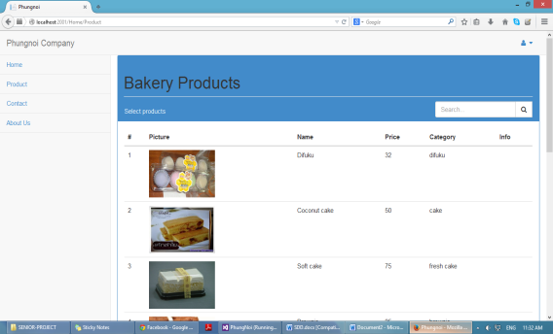


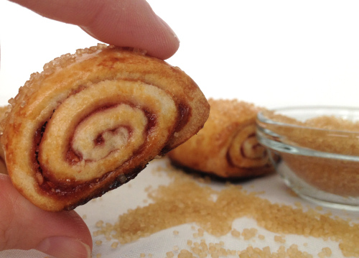
Introduction
Project is web application
Software for ordering bakery product
Software for estimating ingredient in manufacturer
Develop by ASP.NET MVC Framework

Slide 4
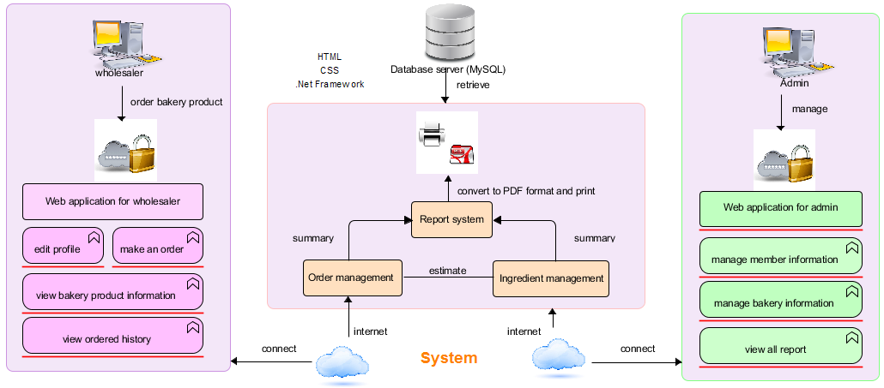
System architecture

Slide 5

Project status report
Project name: Web-based Ordering & Ingredient Estimating for Bakery Manufacturer
Prepared by: Nontra Mahachanont Parinya Panyanak | Date: 24 July 2014 |  | Report Process: Project Progress Report I
Project Overall Status: 40 %
Feature: Member Management and Product Management - Admin can register to activate member. - Admin and wholesaler authenticate the web application account. - Admin can manage all member information. - Wholesaler can update own information. - Admin can manage all bakery product information. - Wholesaler can view all bakery product information.
Milestone Deliverables performance reporting
Milestone Deliverables |  | Due Date | % Complete | Deliverable Status
Project Progress Report I
Software Project Management Plan |  | 31 July 2014 | 100 % | On schedule
Software Requirement Specification |  | 31 July 2014 | 100 % | On schedule
Software Design Document |  | 31 July 2014 | 100 % | On schedule
Software Implementation |  | 31 July 2014 | 100 % | On schedule
Test Plan |  | 31 July 2014 | 100 % | On schedule
Test Record |  | 31 July 2014 | 100 % | On schedule
Traceability Record |  | 31 July 2014 | 100 % | On schedule

Slide 6

No. | Review Item | Responsibility | Reviewer
1 | Project Management Plan | NM | All members Advisor
2 | Project Proposal | All members | All members Advisor
 | Software Requirement Specification | NM | All members Advisor
3 | Software Design Document | PP | All members Advisor
4 | Implementation | PP | All members Advisor
 | Unit Test Report | PP | All members Advisor
5 | System Test Report | PP | All members Advisor
6 | Traceability Record | NM | All members Advisor
 | Project Status Report | NM | All members Advisor
Work list in progress report I

Slide 7
Tasks in Project Progress Report I
Estimate Duration
Development Model
Configuration Item Table
Repository Tool
Change Management
Software project management plan

Slide 8
Estimate duration
Progress | Duration | Tasks
Proposal | Start: 07 February 2014 End: 02 April 2014 | Proposal Document
Progress Report I | Start: 15 April 2014 End: 13 August 2014 | Feature#1: Member Management Feature#2: Product Management
Progress Report II | Start: 20 August 2014 End: 23 September 2014 | Feature#3: Order Management Feature#4: Ingredient Management

Slide 9
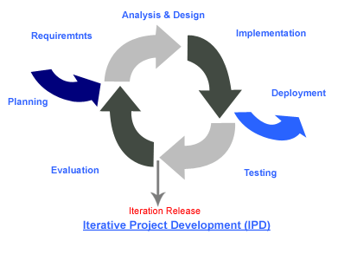
Development model
Iterative Software Development Process
We needed to develop the iterative way for review and improve the software and its documents for each development progress until it has finished.

Slide 10

Change management
No. | Item name | Baseline Version
1 | Project Proposal | 1.4
2 | Project Management Plan | 1.0
Specify baseline version
Approving the change request
URS UTC | URS - 01 | URS - 02 | URS - 03 | URS - 04 | URS - 05 | URS - 06
UTC - 01 |  | X
UTC - 02 |  |  |  | X
Requirement traceability

Slide 11
No. | Item name | File name | File Type | Owner (Role) | Repository (Path) | Baseline Version
1 | Project Proposal | Web-based Ordering & Ingredient Estimating for Bakery Manufacturer – Project Proposal_V.1.4 | .docx | PP, NM | C:\Users\VAiO\Desktop\Senior Project\Project Plan | 1.4
2 | Project Management Plan | Web-based Ordering & Ingredient Estimating for Bakery Manufacturer – PMP_V.1.0 | .docx | PP, NM | C:\Users\VAiO\Desktop\Senior Project\PMP | 1.0
3 | Software Requirement Specification | Web-based Ordering & Ingredient Estimating for Bakery Manufacturer – SRS_V.1.0 | .docx | PP, NM | C:\Users\VAiO\Desktop\Senior Project\SRS | 1.0
4 | Software Design Document | Web-based Ordering & Ingredient Estimating for Bakery Manufacturer – SDD_V.1.0 | .docx | PP, NM | C:\Users\VAiO\Desktop\Senior Project\SDD | 1.0
5 | Test Plan | Web-based Ordering & Ingredient Estimating for Bakery Manufacturer – Test Plan_V.1.0 | .docx | PP, NM | C:\Users\VAiO\Desktop\Senior Project\Test Plan | 1.0
6 | Traceability Record | Web-based Ordering & Ingredient Estimating for Bakery Manufacturer – TR_V.1.0 | .docx | PP, NM | C:\Users\VAiO\Desktop\Senior Project\TR | 1.0
Software configuration item table

Slide 12
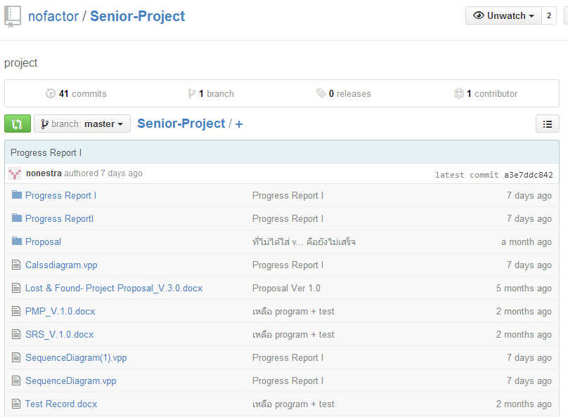

repository tool

Slide 13

Tasks in Project Progress Report I
Analyze Requirement
Software Requirement Specification Document
6 User Requirement Specification (URS)
37 System Requirement Specification (SRS)
11 Activity Diagram (AD)
Software requirement specification

Slide 14
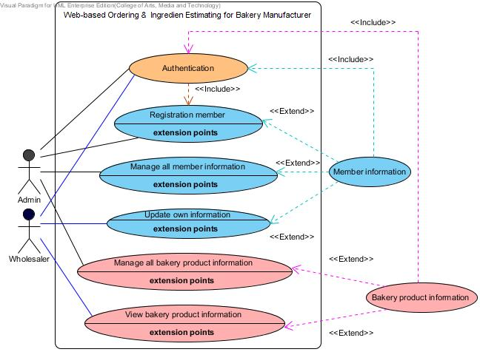
Requirement Analysis
Use Case
Scenario

Slide 15
Example for URS
URS-01: Admin can register to activate member to access the application by create new member information; username, password, first name, last name, phone number, address, user type and profile picture into database.
SRS-01: The system can connect to the database.
SRS-02: The system shall provide a link for register new member information within member management page interface.
SRS-03: The system shall provide a registration form within a creating new member page interface to admin input member information.
SRS-04: The system shall provide service for validation input information.
SRS-05: The system shall provide notification to display a message after submitting a registration form.
SRS-06: The system shall provide service to store information into the database.
SRS-07: The system shall provide a user interface to display the new member information.
Admin side

Slide 16
Use Case ID: | UC – 01
Use Case Name: | Registration member
Actors: | Admin
Short Description: | This use case allows admin can activate member by register them to the website.
Preconditions: | Admin have login to the website.
Post conditions: | Member will use username and password to login to the website.
Normal Flow: | 1. Request a registration link within member management page. 2. Input username, password, first name, last name, phone number, address, user type and profile picture into registration form. 3. Click “Submit” button. 4. System shall checks validation from input information. 5. System shall display successful of registration to user. 6. System shall collect information of registration to the database. (username, password, first name, last name, phone number, address, user type and profile picture) 7. System shall display new member information to user.
Alternative and Exceptional: | 3a. In step 3 of the normal flow. If the input invalid type of information. 3.1 System displays the error message to user. 3.2 System shall request the command from user input again. 3b. In step 3 of the normal flow. If the input valid type of information. 3.1 Use case resumes on step 5 of normal flow. 3c. In step 3 of the normal flow. If the input information is duplicate. 3.1 System displays the error message to user. 3.2 System shall request the command from user input again. 3d. In step 3 of the normal flow. If the input information is not duplicate. 3.1 Use case resumes on step 5 of normal flow.
Use Case Description
UC-01
Registration member

Slide 17
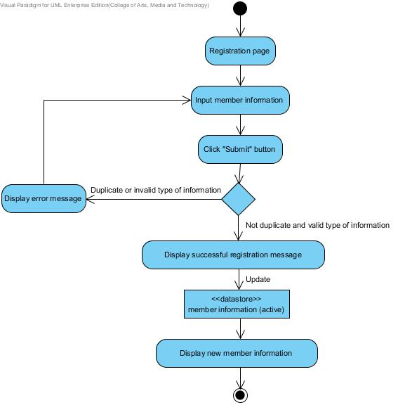
Example for activity diagram
AD-01
Admin registration to active member
Admin side

Slide 18
Tasks in Project Progress Report I
Class Diagram
Software Design Document
10 Sequence Diagram (SD)
3 Database Design(DB)
15 User Interface Design (UI)
Software design

Slide 19
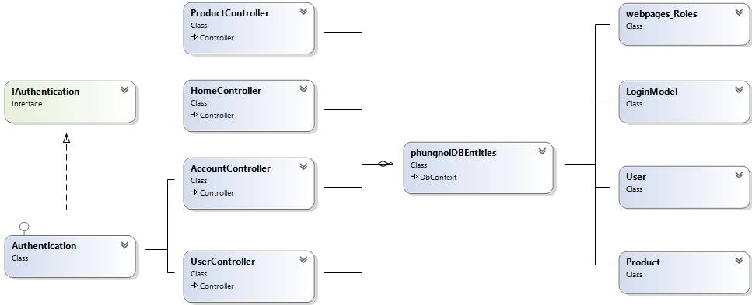
Example for class diagram

Slide 20
Example for
sequence diagram
SD-08: Admin can edit bakery product information.

Slide 21
Example for database design
Field | Type | Extra
id | Int(32) | - Primary Key - Not Null - Auto Incremental
name | String | - Not Null
price | Double | - Not Null
category | String | - Not Null
picture | String | - Not Null
info | String | - Not Null
DB-01: Product

Slide 22
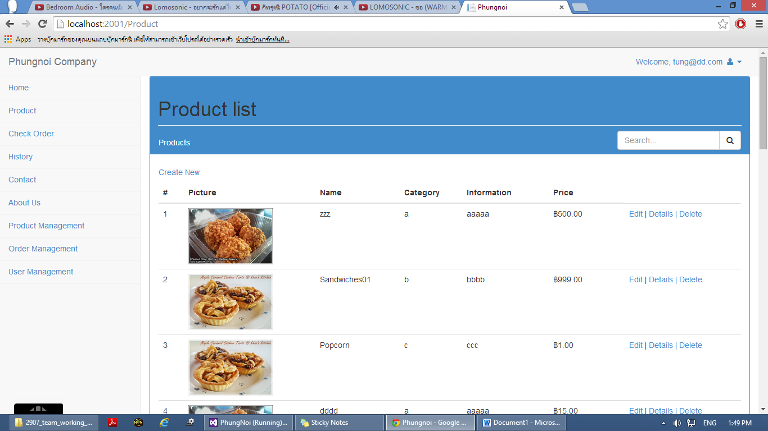
Example for user interface
UI-12: Bakery product management page

Slide 23
Tasks in Project Progress Report I
Developing Tools
Visual Studio 2012
SQL Server Management
Develop software comply with SRS & SDD
Member Management
Product Management
Software implement

Slide 24
Tasks in Project Progress Report I
Test Plan Document
Test Plan
Test Record
Software testing

Slide 25
Example for unit test case
Class: ProductController
Unit Test Case-18 (UTC-18): public ActionResultDelete (int id = 0)
Description: This case used to check Delete (int id = 0) method that can return correct page.
Test Cases:
No. | Description | Input | Expected output
1 | Return delete page of product that is selected | {id == 2} | return View ("Delete", {Name == “Longgang cake”, Price == 50, Category == cake , Picture == \\UploadImages\\2images (4).jpg});
2 | Return delete page of product that is not selected | {id == 500} | return HttpNotFound();

Slide 26
Example for unit Test Record
No. | Expected output | Actual output | Pass/Fail
1 | return View ("Delete", {Name == “Longgang cake”, Price == 50, Category == cake , Picture == \\UploadImages\\2images (4).jpg}); | return View ("Delete", {Name == “Longgang cake”, Price == 50, Category == cake , Picture == \\UploadImages\\2images (4).jpg}); | Pass
2 | return HttpNotFound (); | return HttpNotFound (); | Pass

Slide 27
Example for system testing
System Test Case-02 (STC-02): Admin and wholesaler authenticate the web application account by login.
Description: This test case is a system testing for URS-02. Admin and wholesaler can authentication to the web application account by login.
Prerequisite: User must have accounted.
Test Script: 1. Top right of page, user clicks “menu” list.
2. User selects “Login” link.
3. User fills username as “tung@dd.com” and password “123456”.
4. User clicks “Login” button to sign in to the system.

Slide 28
No. | Description | Input | Expected output
1 | Test with inputs correct both username and password to the login form. | Username = tung@dd.com Password = 123456 | The system will redirect to Index page.
2 | Test with inputs username is invalid with password in the database. | Username = tung@gmail.com Password = 147852369 | Display error message “The user name or password are incorrect.” After that the system give user input information again.
3 | Test with inputs username is not Email in login form. | Username = “No” Password = 123456 | Display error message “Please input with Email.” After that the system give user input information again.
4 | Test with do not inputs username information to login form. | Username = “ ” Password = 123456 | Display error message “Username is required.” After that the system give user input information again.
5 | Test with do not inputs password information to login form. | Username = tung@dd.com Password = “ ” | Display error message “Password is required.” After that the system give user input information again.
6 | Test with login can reach and keep sign in date. | - | Login to the system success and keep sign in date in the database.
Test Cases

Slide 29
No. | Expected Result | Actual Result | Pass/Fail
1 | The system will redirect to Index page. | The system will redirect to Index page. | Pass
2 | Display error message “The user name or password are incorrect.” After that the system give user input information again. | Display error message “The user name or password are incorrect.” After that the system give user input information again. | Pass
3 | Display error message “Please input with Email.” After that the system give user input information again. | Display error message “Please input with Email.” After that the system give user input information again. | Pass
4 | Display error message “Username is required.” After that the system give user input information again. | Display error message “Username is required.” After that the system give user input information again. | Pass
5 | Display error message “Password is required.” After that the system give user input information again. | Display error message “Password is required.” After that the system give user input information again. | Pass
6 | Login to the system success and keep sign in date in the database. | Login to the system success and keep sign in date in the database. | Pass
System Test Record

Slide 30
Traceability Record
User Requirement Specification Activity Diagram | URS - 01 | URS - 02 | URS - 03 | URS - 04 | URS - 05 | URS - 06
AD - 01: Admin register to active member | X
AD - 02: Admin and Wholesaler login to the system |  | X
AD - 03: Admin and wholesaler logout from the system |  | X
AD - 04: Admin update member information |  |  | X
AD - 05: Admin delete member information |  |  | X
AD - 06: Wholesaler update own information |  |  |  | X
AD - 07: Admin view member information |  |  | X
AD - 08: Admin add bakery product information |  |  |  |  | X
AD - 09: Admin update bakery product information |  |  |  |  | X
AD - 10: Admin delete bakery product information |  |  |  |  | X
AD - 11: Admin and Wholesaler view bakery product information |  |  |  |  | X | X
Activity Diagram and User Requirement Specification

Slide 31


Demo

Slide 32
Problems
Some Unit test is error and fail.
Wrong word spelling and grammar in documents.
Bad communication within team members.
Requirements might be change
Deliverables delay.

Slide 33
Thank you for your attention

Slide 34
Q & A

